Slide 1
SQL Injection Juice Shop Lab

Slide 2
SQL Injection Lab
Materials needed
Kali Virtual Machine (With Juice Shop)
Software Tool used
Juice Shop
Follow the Juice Shop Setup Lab if not previously installed/available on your VM

Slide 3
Objectives Covered
Security+ Objectives (SY0-601)
Objective 1.3 - Given a scenario, analyze potential indicators associated with application attacks.
Injections
Structured query language (SQL)

Slide 4
What is an SQL Injection Attack?
A SQL Injection is an injection attack where attackers use SQL commands to bypass a website's security to gain access to data
The hackers could gain access to personal and private information from this database

Slide 5
The SQL Injection Lab
Setup environments
Access Juice Shop website
SQL Injection

Slide 6
Setup Environments
Log into your range
Open the Kali Linux Environments
You should be on your Kali Linux Desktop
Open a new Terminal

Slide 7
Access Juice Shop website
Navigate to the juice-shop directory and start npm
cd juice-shop
npm start
Open Firefox and navigate to:
localhost:3000

Slide 8
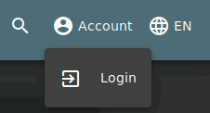
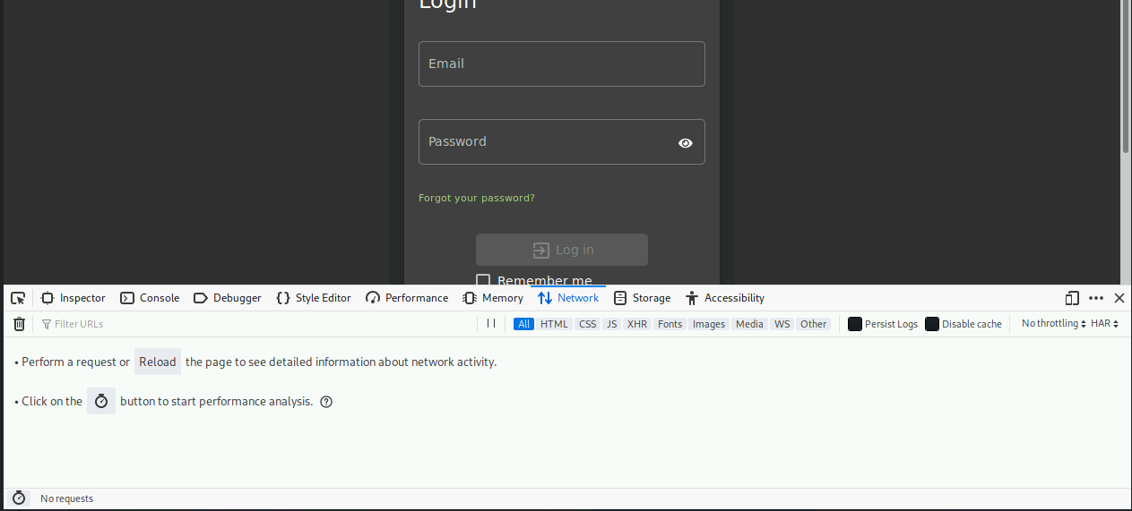
SQL Injection
In the top right corner of the Juice Shop webpage, click Account, then Login
View the SQL query
Open the network monitor tab in the Developer’s Tools
Press CTRL+SHIFT+E to open this monitor
Verify the Developer’s Tools has opened and on the Network tab

Slide 9
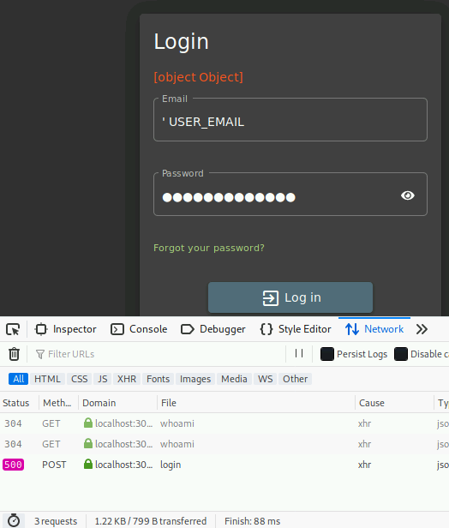
SQL Injection
Create a login error.
Use ‘ USER_EMAIL for the email
Use USER_PASSWORD for the password
Don’t forget the apostrophe!
You should receive ‘Invalid email or password’
Notice, two GET and 1 POST have been captured

Slide 10
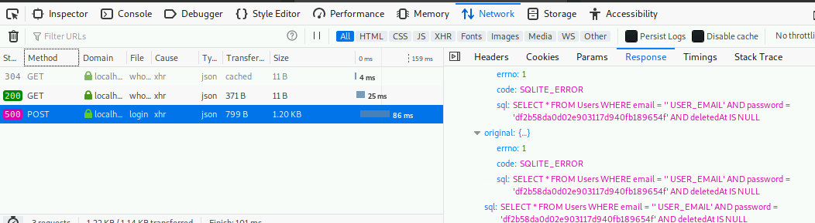
SQL Injection
Select the POST that was captured
Click the Response tab (on the right)
Find the ‘ USER_EMAIL that was captured
2. Click the Response Tab
1. Click the post method
3. Find the SQLITE error and command entered

Slide 11
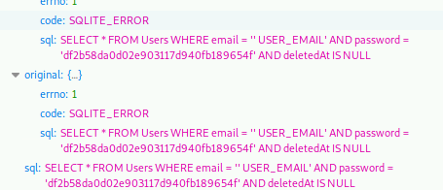
SQL Injection
What is this error telling us?
SQL Command is the following:
SELECT * FROM Users WHERE email = ‘ EMAIL_INPUT’ AND password = ‘HASHED_PASSWORD’ AND deletedAt IS NULL
SQL command being entered when a Username and Password are tried
Notice: The password is converted to a hash

Slide 12
SQL Injection
What happens if we use ‘ OR TRUE -- as the email address?
This would make the SQL command look like this:
SELECT * FROM Users WHERE email = ‘‘ OR TRUE -- AND password = ‘HASHED_PASSWORD’ AND deletedAt IS NULL
This SQL command is going to allow us to use any password to login

Slide 13
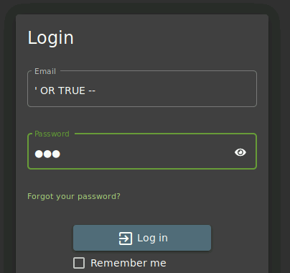
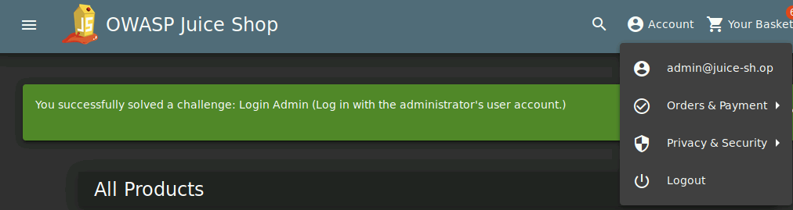
SQL Injection
Enter the following credentials:
Email: ' OR TRUE --
Password: 111
Verify this has logged the user in as the Admin account

Slide 14
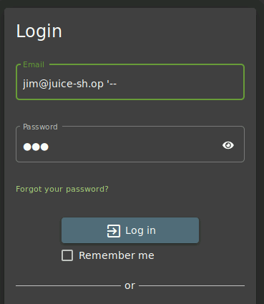
SQL Injection
If you happen to know more usernames, you can access their accounts too. You could find a database of usernames (which is a Juice Shop challenge) but we'll just use the following:
Jim, jim@juice-sh.op
Bender, bender@juice-sh.op
Chris, chris.pike@juice-sh.op
The key is to add ' -- at the end of each username, e.g. jim@juice-sh.op' -- with any password.
Note, based on the challenge completed using Chris's login, what can you conclude?
Chris's account was a deleted account

Slide 15
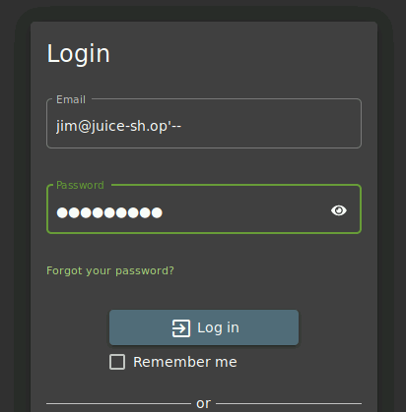
SQL Injection
This Email should log into Jim’s Juice Shop account
Please Note: Make sure there are no spaces in the email address!
Any password can be used

Slide 16
How to Defend Against an SQL Injection Attack?
Limit information available in a database
Why are hashed passwords stored on this database?
Sanitize the inputs!
Reject inputs that are not what the search was meant for
NEVER trust user input – check it
Enumerate options for the user
Numeric fields do not contain characters
Email fields look like actual email addresses (what's that pattern look like?)
What are some other ways of defending against an SQL Injection attack?

